Slide 1


o
s
Twitter Sentiment Analysis on Tech Products
PRESENTED BY: GROUP 3

Slide 2






MEET OUR TEAM
Wamuyu Gitonga – Team Lead
Vanessa Sandra
John Njogu
Natalie Wanjiku
Leejay Mwakireti
Lillian Wangui

Slide 3
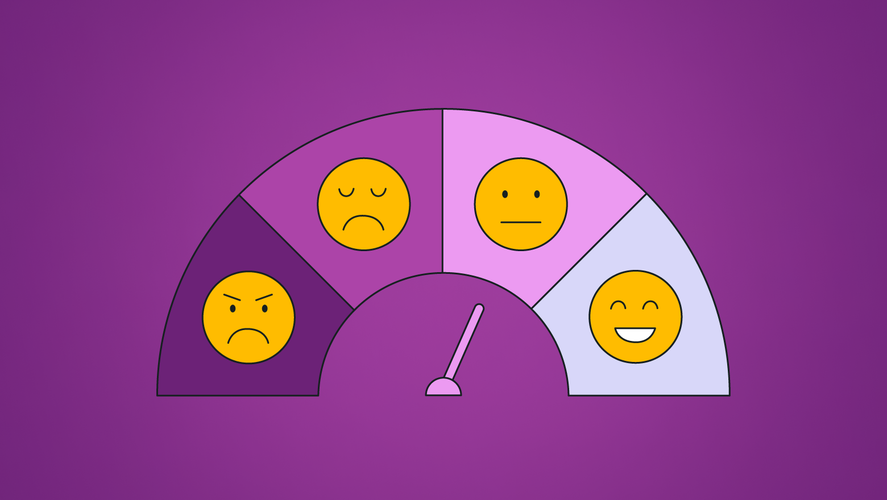
AGENDA
Data Source
Objective
Dataset Overview
Data Quality
Descriptive Analysis
Trends & Categories
Model Performance
Key Insights
Recommendations
Conclusion

Slide 4

DATA SOURCE
The dataset comes from CrowdFlower via [data.world](https://data.world/crowdflower/brands-and-product-emotions/workspace/file?filename=judge-1377884607_tweet_product_company.csv).
This dataset is highly suitable because the text of Tweets directly reflects customer opinions. Analyzing these Tweets allows stakeholders (product managers, marketing teams) to understand public sentiment efficiently without manually reading thousands of messages.

Slide 5

OBJECTIVES
Analyze Twitter conversations about Apple, Google, and Android products using natural language processing (NLP) techniques
Classify tweets into positive, negative and neutral sentiment patterns
Build Machine Learning (ML) models to classify sentiments automatically
Extract insights to support businesses, marketers, and stakeholders in the tech industry to track consumer sentiment, benchmark against competitors, and drive data-informed decisions

Slide 6
DATASET OVERVIEW
The CSV file contains 9093 rows of tweets and 3 columns
Columns include: tweet text, product mentioned, sentiment label
Focus: Sentiment directed at tech brands/products

Slide 7
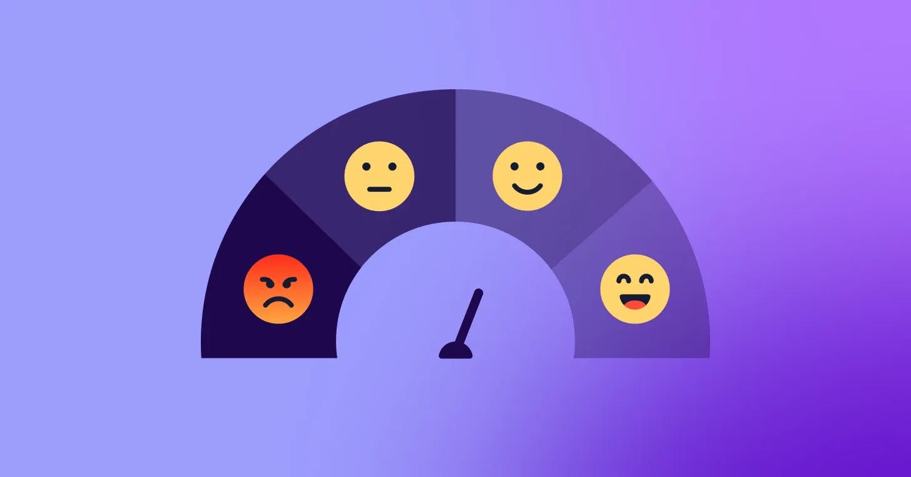
DATASET QUALITY CHECKS
Checked for missing values and duplicated records
Validated sentiment categories (Positive, Negative, Neutral) and standardization
Cleaned noisy text for analysis

Slide 8
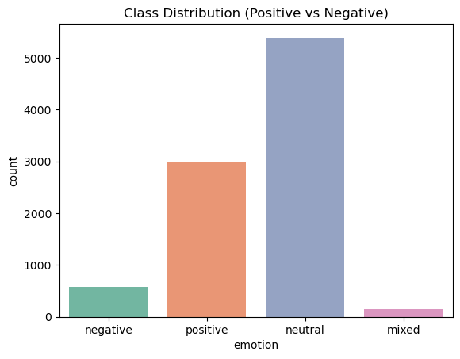
EXPLORATORY DATA ANALYSIS
Shows the distribution of sentiments

Slide 9
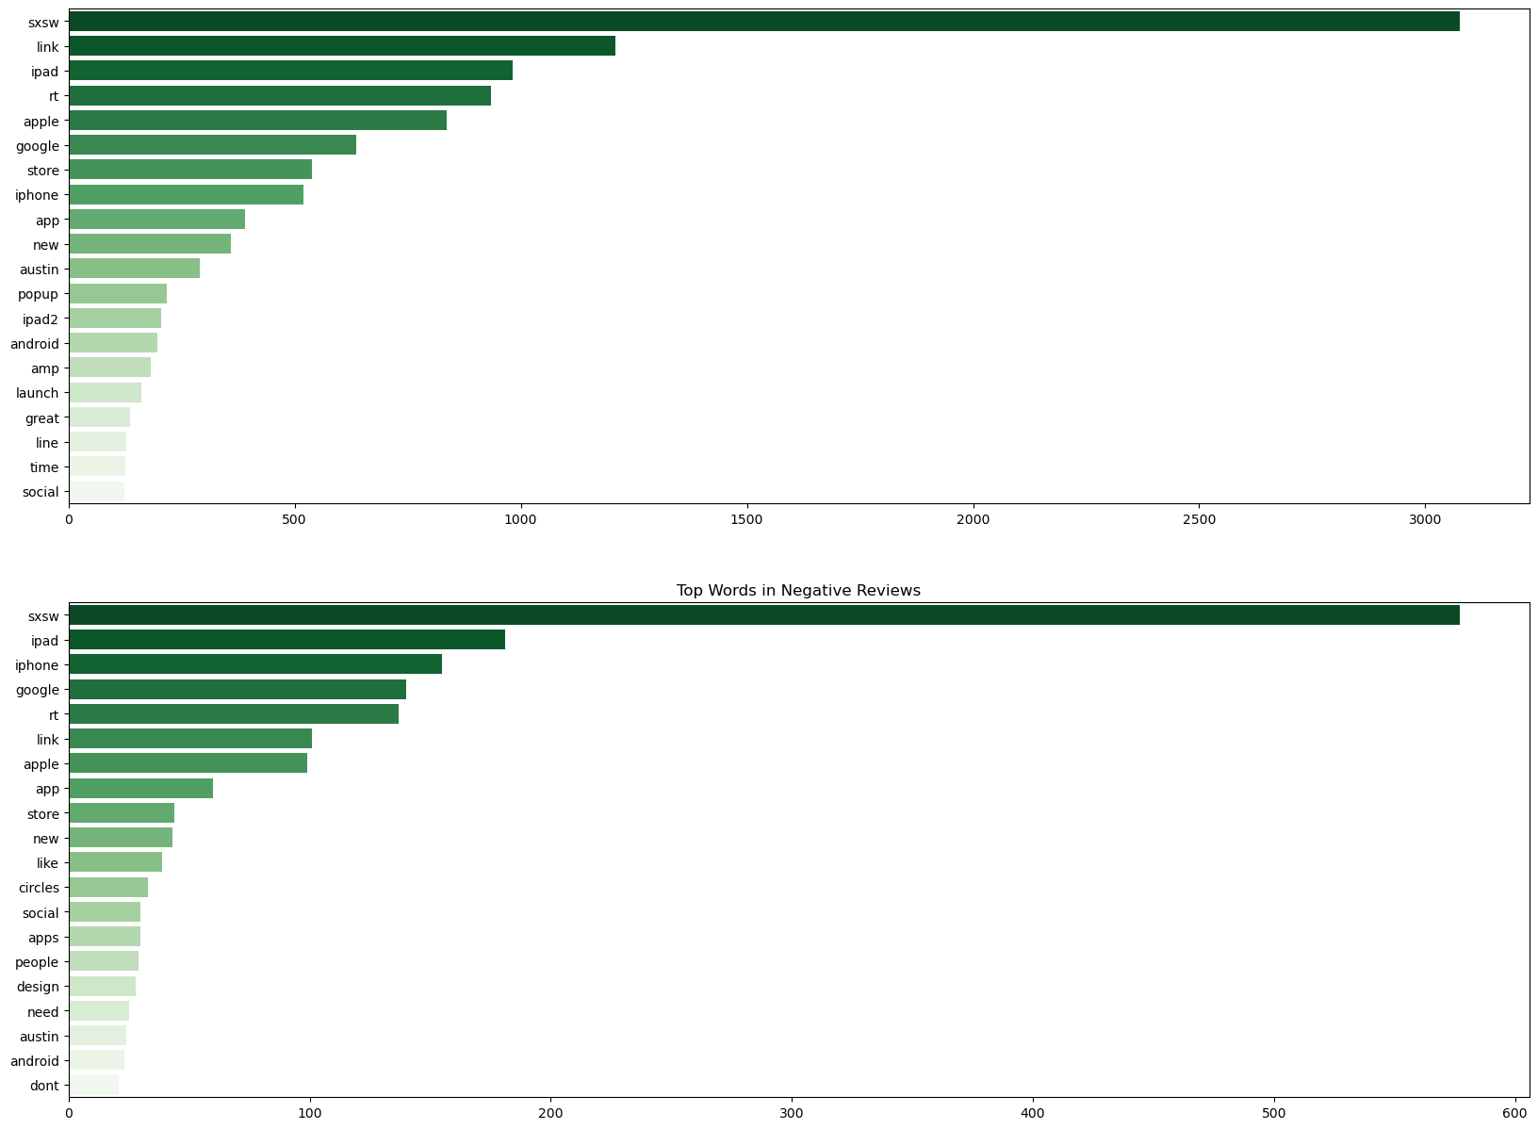
Shows the distribution of words in Positive and Negative Reviews

Slide 10
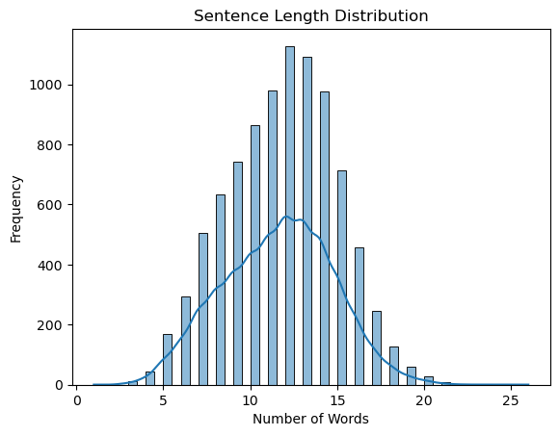
Shows the sentence length distribution

Slide 11
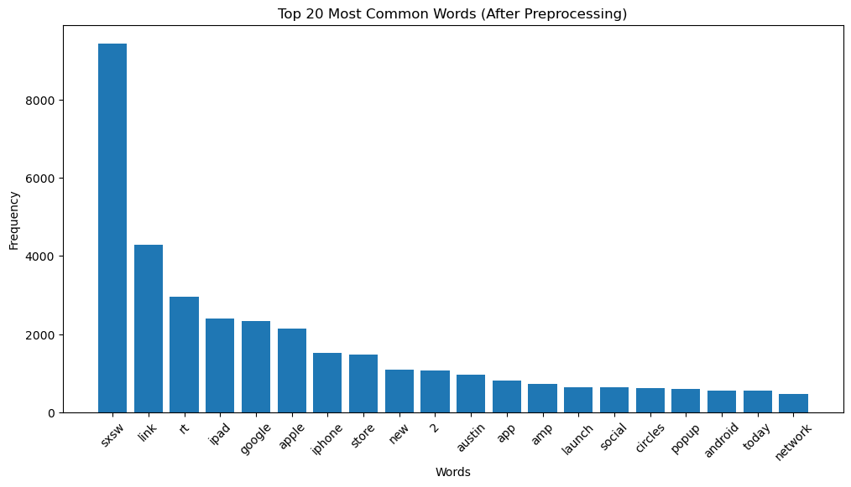
Shows the most common words used after preprocessing

Slide 12
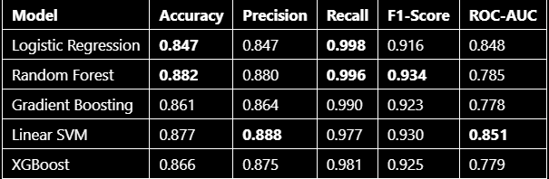
MODEL TRAINING
MODEL EVALUATION
We trained our models to correctly classify whether a tweet is negative or positive. The models used were:
- Logistic Regression
- SVM
- Random Forest
- XGBoost
Gradient Descent
TF-IDF to vectorize our data, and logistic regression to classify it.
SMOTE applied to handle class imbalance
This table compares five different machine learning models across five key evaluation metrics.
Summary and Recommendation
Best Overall Model: Random Forest, due to its highest Accuracy and F1-score, which best balances the trade-off between false positives and false negatives.
Best for High-Certainty Predictions: Linear SVM, if your priority is minimizing false positives (i.e., you want to be very sure a prediction is positive when you make it).
Key Observation: All models have exceptionally high Recall (>0.97). This means they are all very good at capturing nearly all positive instances in the data. The primary differences between them lie in how many false positives they generate (reflected in Precision).

Slide 13
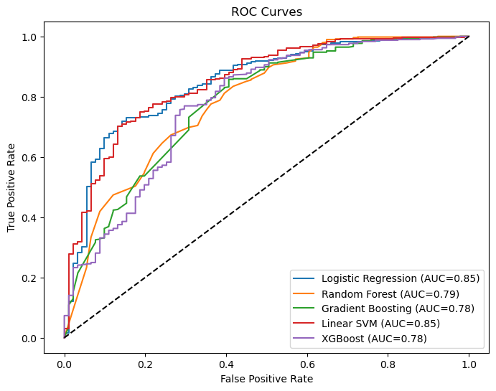
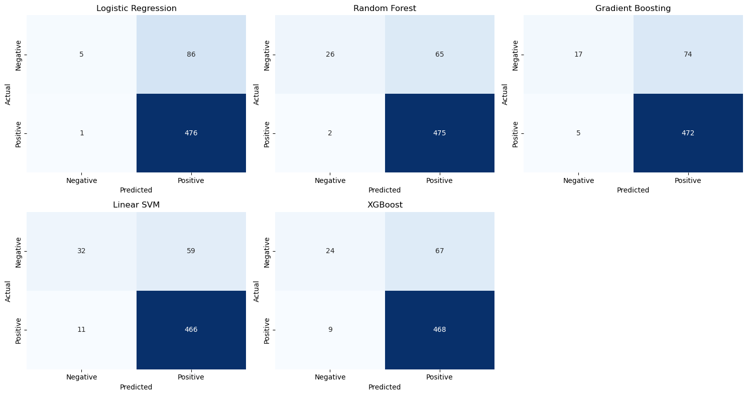

Slide 14

KEY INSIGHTS
Random Forest is the best model overall
Linear SVM performs strongly in ROC-AUC
Sentiment classification is highly accurate (>85%)
Tech brands have strong positive sentiment, especially Apple
1
2
3
4

Slide 15
RECOMMENDATIONS
General Sentiment Trends – Track overall positive vs. negative sentiment (e.g., “60% positive, 40% negative”) and address spikes in negativity with responsive campaigns.
Positive Drivers – Amplify what users already love (e.g., Google Pixel’s camera, iPhone’s ecosystem) through ads, influencer marketing, and social proof.
Negative Pain Points – Identify top complaints (e.g., iPhone battery life, Android bloatware) and directly counter them with messaging, feature highlights, or improved support.
Competitive Benchmarking – Compare sentiment across Apple vs. Google, iPhone vs. Android, and use competitor weaknesses as positioning opportunities.
Actionable Monitoring – Build a live dashboard to track sentiment shifts after launches or campaigns, ensuring marketing actions are data-driven and adaptive.
1
2
3
4
5

Slide 16
CONCLUSION
Dataset provides valuable insights on customer sentiment
ML models achieve high accuracy and reliability
Findings can guide marketing, product strategy, and customer engagement
Next step: Implement sentiment monitoring pipeline
1
2
3
4

Slide 17
THANK YOU

